Slide 1
Network Layer
Logical Addressing

Slide 2
IPv4 ADDRESSES
An IPv4 address is a 32-bit address that uniquely and universally defines the connection of a device (for example, a computer or a router) to the Internet.
Topics discussed in this section:
Address Space
Notations
Classful Addressing
Classless Addressing
Network Address Translation (NAT)

Slide 3

Note
An IPv4 address is 32 bits long.

Slide 4
Note
The IPv4 addresses are unique
and universal.

Slide 5
Note
The address space of IPv4 is
2³² or 4,294,967,296.

Slide 6

Figure 19.1 Dotted-decimal notation and binary notation for an IPv4 address

Slide 7
Note
Numbering systems are reviewed in Appendix B.

Slide 8


Example 19.1
Change the following IPv4 addresses from binary notation to dotted-decimal notation.
Solution
We replace each group of 8 bits with its equivalent decimal number (see Appendix B) and add dots for separation.

Slide 9


Example 19.2
Change the following IPv4 addresses from dotted-decimal notation to binary notation.
Solution
We replace each decimal number with its binary equivalent (see Appendix B).

Slide 10

Example 19.3
Find the error, if any, in the following IPv4 addresses.
Solution
a. There must be no leading zero (045).
b. There can be no more than four numbers.
c. Each number needs to be less than or equal to 255.
d. A mixture of binary notation and dotted-decimal
notation is not allowed.

Slide 11
Note
In classful addressing, the address space is divided into five classes:
A, B, C, D, and E.

Slide 12

Figure 19.2 Finding the classes in binary and dotted-decimal notation

Slide 13
Example 19.4
Find the class of each address.
a. 00000001 00001011 00001011 11101111
b. 11000001 10000011 00011011 11111111
c. 14.23.120.8
d. 252.5.15.111
Solution
a. The first bit is 0. This is a class A address.
b. The first 2 bits are 1; the third bit is 0. This is a class C
address.
c. The first byte is 14; the class is A.
d. The first byte is 252; the class is E.

Slide 14

Table 19.1 Number of blocks and block size in classful IPv4 addressing

Slide 15
Note
In classful addressing, a large part of the available addresses were wasted.

Slide 16

Table 19.2 Default masks for classful addressing

Slide 17
Note
Classful addressing, which is almost obsolete, is replaced with classless addressing.

Slide 18
Example 19.5
Figure 19.3 shows a block of addresses, in both binary and dotted-decimal notation, granted to a small business that needs 16 addresses.
We can see that the restrictions are applied to this block. The addresses are contiguous. The number of addresses is a power of 2 (16 = 2⁴), and the first address is divisible by 16. The first address, when converted to a decimal number, is 3,440,387,360, which when divided by 16 results in 215,024,210.

Slide 19

Figure 19.3 A block of 16 addresses granted to a small organization

Slide 20
Note
In IPv4 addressing, a block of
addresses can be defined as
x.y.z.t /n
in which x.y.z.t defines one of the addresses and the /n defines the mask.

Slide 21
Note
The first address in the block can be found by setting the rightmost
32 − n bits to 0s.

Slide 22
Example 19.6
A block of addresses is granted to a small organization. We know that one of the addresses is 205.16.37.39/28. What is the first address in the block?
Solution
The binary representation of the given address is
11001101 00010000 00100101 00100111
If we set 32−28 rightmost bits to 0, we get
11001101 00010000 00100101 0010000
or
205.16.37.32.
This is actually the block shown in Figure 19.3.

Slide 23
Note
The last address in the block can be found by setting the rightmost
32 − n bits to 1s.

Slide 24
Example 19.7
Find the last address for the block in Example 19.6.
Solution
The binary representation of the given address is
11001101 00010000 00100101 00100111
If we set 32 − 28 rightmost bits to 1, we get
11001101 00010000 00100101 00101111
or
205.16.37.47
This is actually the block shown in Figure 19.3.

Slide 25
Note
The number of addresses in the block can be found by using the formula
2^{32−n}.

Slide 26
Example 19.8
Find the number of addresses in Example 19.6.
Solution
The value of n is 28, which means that number
of addresses is 2 ³²⁻²⁸ or 16.

Slide 27
Example 19.9
Another way to find the first address, the last address, and the number of addresses is to represent the mask as a 32-bit binary (or 8-digit hexadecimal) number. This is particularly useful when we are writing a program to find these pieces of information. In Example 19.5 the /28 can be represented as
11111111 11111111 11111111 11110000
(twenty-eight 1s and four 0s).
Find
a. The first address
b. The last address
c. The number of addresses.

Slide 28

Example 19.9 (continued)
Solution
a. The first address can be found by ANDing the given
addresses with the mask. ANDing here is done bit by
bit. The result of ANDing 2 bits is 1 if both bits are 1s;
the result is 0 otherwise.

Slide 29

Example 19.9 (continued)
b. The last address can be found by ORing the given
addresses with the complement of the mask. ORing
here is done bit by bit. The result of ORing 2 bits is 0 if
both bits are 0s; the result is 1 otherwise. The
complement of a number is found by changing each 1
to 0 and each 0 to 1.

Slide 30
Example 19.9 (continued)
c. The number of addresses can be found by
complementing the mask, interpreting it as a decimal
number, and adding 1 to it.

Slide 31
Figure 19.4 A network configuration for the block 205.16.37.32/28

Slide 32
Note
The first address in a block is
normally not assigned to any device;
it is used as the network address that represents the organization
to the rest of the world.

Slide 33

Figure 19.5 Two levels of hierarchy in an IPv4 address

Slide 34

Figure 19.6 A frame in a character-oriented protocol

Slide 35
Note
Each address in the block can be considered as a two-level
hierarchical structure:
the leftmost n bits (prefix) define
the network;
the rightmost 32 − n bits define
the host.

Slide 36

Figure 19.7 Configuration and addresses in a subnetted network

Slide 37

Figure 19.8 Three-level hierarchy in an IPv4 address

Slide 38
Example 19.10
An ISP is granted a block of addresses starting with 190.100.0.0/16 (65,536 addresses). The ISP needs to distribute these addresses to three groups of customers as follows:
a. The first group has 64 customers; each needs 256
addresses.
b. The second group has 128 customers; each needs 128
addresses.
c. The third group has 128 customers; each needs 64
addresses.
Design the subblocks and find out how many addresses are still available after these allocations.

Slide 39

Example 19.10 (continued)
Solution
Figure 19.9 shows the situation.
Group 1
For this group, each customer needs 256 addresses. This means that 8 (log2 256) bits are needed to define each host. The prefix length is then 32 − 8 = 24. The addresses are

Slide 40

Example 19.10 (continued)
Group 2
For this group, each customer needs 128 addresses. This means that 7 (log2 128) bits are needed to define each host. The prefix length is then 32 − 7 = 25. The addresses are

Slide 41

Example 19.10 (continued)
Group 3
For this group, each customer needs 64 addresses. This means that 6 (log₂64) bits are needed to each host. The prefix length is then 32 − 6 = 26. The addresses are
Number of granted addresses to the ISP: 65,536
Number of allocated addresses by the ISP: 40,960
Number of available addresses: 24,576

Slide 42

Figure 19.9 An example of address allocation and distribution by an ISP

Slide 43

Table 19.3 Addresses for private networks

Slide 44

Figure 19.10 A NAT implementation

Slide 45

Figure 19.11 Addresses in a NAT

Slide 46

Figure 19.12 NAT address translation

Slide 47

Table 19.4 Five-column translation table

Slide 48

Figure 19.13 An ISP and NAT

Slide 49
19-2 IPv6 ADDRESSES
Despite all short-term solutions, address depletion is still a long-term problem for the Internet. This and other problems in the IP protocol itself have been the motivation for IPv6.
Topics discussed in this section:
Structure
Address Space

Slide 50
Note
An IPv6 address is 128 bits long.

Slide 51

Figure 19.14 IPv6 address in binary and hexadecimal colon notation

Slide 52

Figure 19.15 Abbreviated IPv6 addresses

Slide 53

Example 19.11
Expand the address 0:15::1:12:1213 to its original.
Solution
We first need to align the left side of the double colon to the left of the original pattern and the right side of the double colon to the right of the original pattern to find how many 0s we need to replace the double colon.
This means that the original address is.

Slide 54

Table 19.5 Type prefixes for IPv6 addresses

Slide 55

Table 19.5 Type prefixes for IPv6 addresses (continued)

Slide 56

Figure 19.16 Prefixes for provider-based unicast address

Slide 57

Figure 19.17 Multicast address in IPv6

Slide 58

Figure 19.18 Reserved addresses in IPv6

Slide 59

Figure 19.19 Local addresses in IPv6

Slide 60
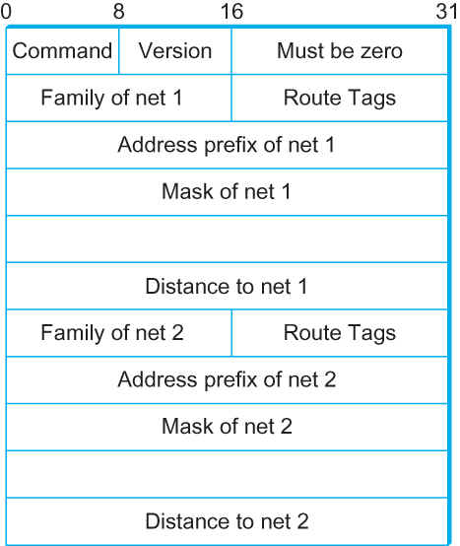
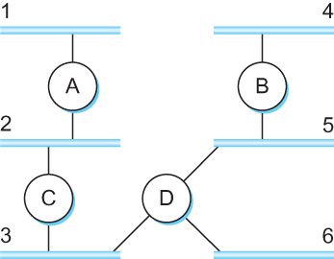
Routing Information Protocol (RIP)
  Example Network
  running RIP RIPv2 Packet Format

Slide 61
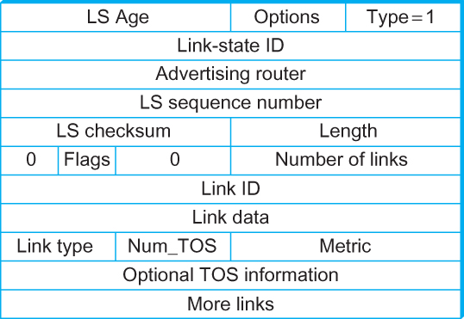
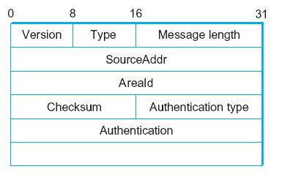
Open Shortest Path First (OSPF)
  OSPF Header Format OSPF Link State Advertisement

Slide 62
Interdomain Routing (BGP)
Internet is organized as autonomous systems (AS) each of which is under the control of a single administrative entity
Autonomous System (AS)
  corresponds to an administrative domain
  examples: University, company, backbone network
A corporation’s internal network might be a single AS, as may the network of a single Internet service provider

Slide 63
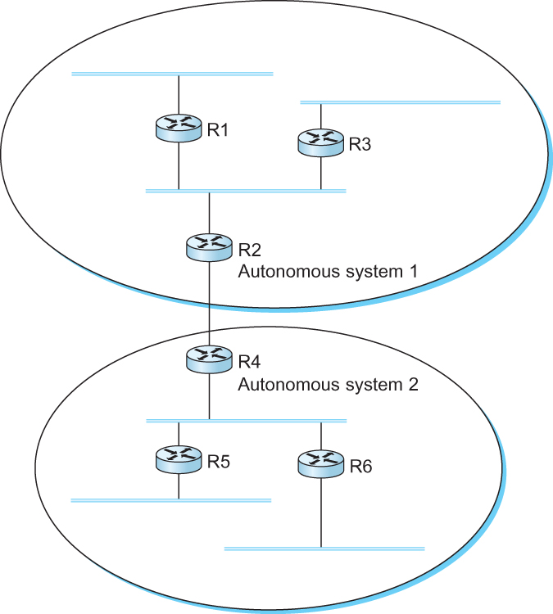
Interdomain Routing
A network with two autonomous system

Slide 64
Route Propagation
Idea: Provide an additional way to hierarchically aggregate routing information is a large internet.
  Improves scalability
Divide the routing problem in two parts:
  Routing within a single autonomous system
  Routing between autonomous systems
Another name for autonomous systems in the Internet is routing domains
  Two-level route propagation hierarchy
    Inter-domain routing protocol (Internet-wide standard)
    Intra-domain routing protocol (each AS selects its own)

Slide 65
EGP and BGP
Inter-domain Routing Protocols
  Exterior Gateway Protocol (EGP)
    Forced a tree-like topology onto the Internet
    Did not allow for the topology to become general
      Tree like structure: there is a single backbone and autonomous systems are connected only as parents and children and not as peers
  Border Gateway Protocol (BGP)
    Assumes that the Internet is an arbitrarily interconnected set of ASs.
    Today’s Internet consists of an interconnection of multiple backbone networks (they are usually called service provider networks, and they are operated by private companies rather than the government)
    Sites are connected to each other in arbitrary ways

Slide 66
BGP
Some large corporations connect directly to one or more of the backbone, while others connect to smaller, non-backbone service providers.
Many service providers exist mainly to provide service to “consumers” (individuals with PCs in their homes), and these providers must connect to the backbone providers
Often many providers arrange to interconnect with each other at a single “peering point”

Slide 67
BGP-4: Border Gateway Protocol
Assumes the Internet is an arbitrarily interconnected set of AS's.
Define local traffic as traffic that originates at or terminates on nodes within an AS, and transit traffic as traffic that passes through an AS.
We can classify AS's into three types:
  Stub AS: an AS that has only a single connection to one other AS; such an AS will only carry local traffic.
  Multi-homed AS: an AS that has connections to more than one other AS, but refuses to carry transit traffic.
  Transit AS: an AS that has connections to more than one other AS, and is designed to carry both transit and local traffic.

Slide 68
BGP
The goal of Inter-domain routing is to find any path to the intended destination that is loop free
  We are concerned with reachability than optimality
  Finding path anywhere close to optimal is considered to be a great achievement
Why?

Slide 69
BGP
Scalability: An Internet backbone router must be able to forward any packet destined anywhere in the Internet
  Having a routing table that will provide a match for any valid IP address
Autonomous nature of the domains
  It is impossible to calculate meaningful path costs for a path that crosses multiple ASs
  A cost of 1000 across one provider might imply a great path but it might mean an unacceptable bad one from another provid
Issues of trust
  Provider A might be unwilling to believe certain advertisements from provider B

Slide 70
BGP
Each AS has:
One BGP speaker that advertises:
  local networks
  other reachable networks (transit AS only)
  gives path information
In addition to the BGP speakers, the AS has one or more border “gateways” which need not be the same as the speakers
The border gateways are the routers through which packets enter and leave the AS

Slide 71
BGP
BGP does not belong to either of the two main classes of routing protocols (distance vectors and link-state protocols)
BGP advertises complete paths as an enumerated lists of ASs to reach a particular network

Slide 72
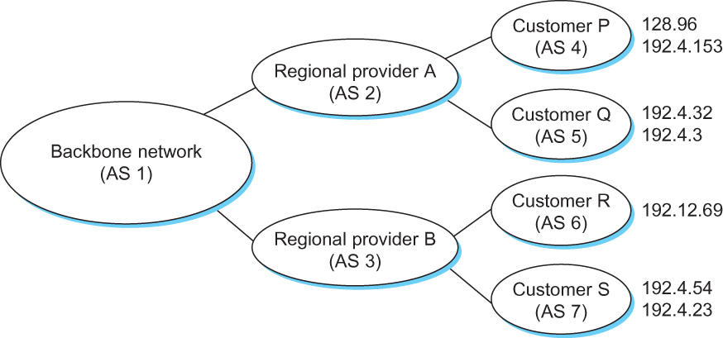
BGP Example
Example of a network running BGP

Slide 73
BGP Example
Speaker for AS 2 advertises reachability to P and Q
  Network 128.96, 192.4.153, 192.4.32, and 192.4.3, can be reached directly from AS 2.
Speaker for backbone network then advertises
  Networks 128.96, 192.4.153, 192.4.32, and 192.4.3 can be reached along the path <AS 1, AS 2>.
Speaker can also cancel previously advertised paths

Slide 74
Distance Vector
Slightly different circumstances can prevent the network from stabilizing
  Suppose the link from A to E goes down
  In the next round of updates, A advertises a distance of infinity to E, but B and C advertise a distance of 2 to E
  Depending on the exact timing of events, the following might happen
    Node B, upon hearing that E can be reached in 2 hops from C, concludes that it can reach E in 3 hops and advertises this to A
    Node A concludes that it can reach E in 4 hops and advertises this to C
    Node C concludes that it can reach E in 5 hops; and so on.
    This cycle stops only when the distances reach some number that is large enough to be considered infinite
      Count-to-infinity problem

Slide 75
Count-to-infinity Problem
Use some relatively small number as an approximation of infinity
For example, the maximum number of hops to get across a certain network is never going to be more than 16
One technique to improve the time to stabilize routing is called split horizon
  When a node sends a routing update to its neighbors, it does not send those routes it learned from each neighbor back to that neighbor
  For example, if B has the route (E, 2, A) in its table, then it knows it must have learned this route from A, and so whenever B sends a routing update to A, it does not include the route (E, 2) in that update

Slide 76
Count-to-infinity Problem
In a stronger version of split horizon, called split horizon with poison reverse
  B actually sends that back route to A, but it puts negative information in the route to ensure that A will not eventually use B to get to E
  For example, B sends the route (E, ∞) to A

